Slide 1
Data Provisioning Toolkit
Monitoring Visit E-Net
Open Data Lab Jakarta
March 26, 2015

Slide 2
WORKFLOW
HTML
PDF
JPG
XLS
Scraping
Tabular
Restructuring
Cleaning
Converting
CSV
Publishing

Slide 3
OPENNESS SPECTRUM
CLOSED DATA
OPEN DATA
more open
1 | Accessibility | Access is limited to a specific individual or group | Open access for everyone
2 | Ease to Process | Data is stored in a format that is difficult to be processed | Available in a format that is computer-friendly
3 | Price | Need to pay | For free / Gratis
4 | Use Rights | Reuse is forbidden and distribution is limited | Data is free to use, reuse and redistributed
Sumber: Michael Chui "The Economic Potential of Open Data"

Slide 4
COMMA SEPARATED VALUES (CSV)
name,gender,birthdate,city,salary
John Smith,M,1970-07-12,Bogor,24000
Mary Smith,F,1976-02-11,Tangerang,50000
Tony Money,M,1980-03-05,Depok,48000
Cindy Moon,F,1984-08-08,Jakarta,120000
Dodi Wandi,M,1981-01-24,Jakarta,12000

Slide 5
WORKFLOW
HTML
PDF
JPG
XLS
Scraping
Tabular
Restructuring
Cleaning
Converting
CSV
Publishing

Slide 6
Data Scraping

Slide 7
WEB SCRAPING
Google Docs: IMPORTHTML(url, query, index)
url - The URL of the page to examine,
query - Either "list" or "table" depending on what type of structure contains the desired data,
index - The index, starting at 1, which identifies which table or list as defined in the HTML source.

Slide 8
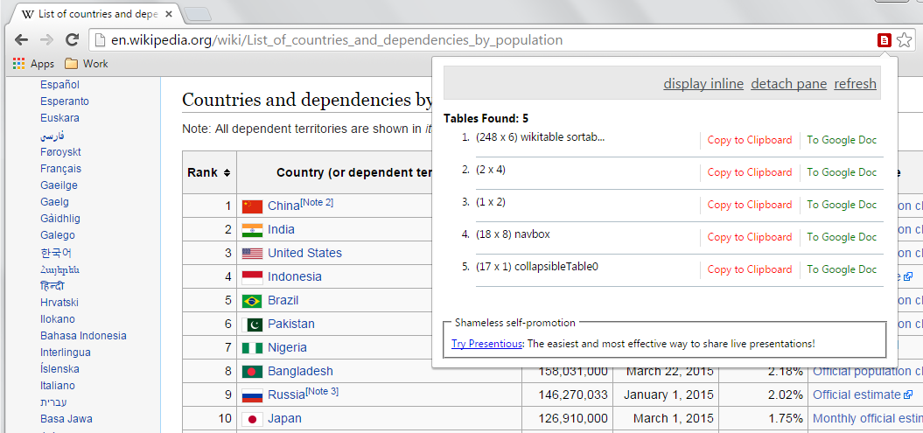
WEB SCRAPING
2. Google Chrome Extensions: Table Capture.

Slide 9
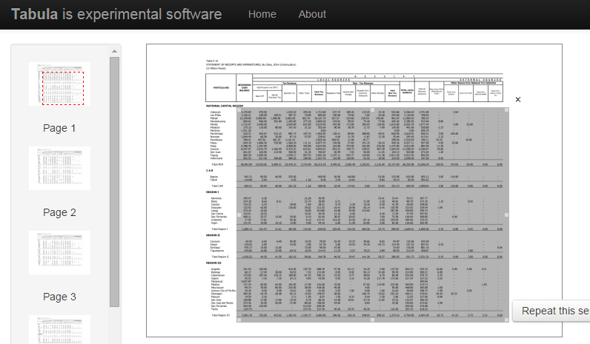
PDF SCRAPING
Tabula (http://tabula.technology)

Slide 10
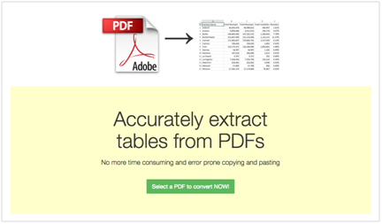
PDF SCRAPING
2. PDF Tables (https://pdftables.com/)

Slide 11
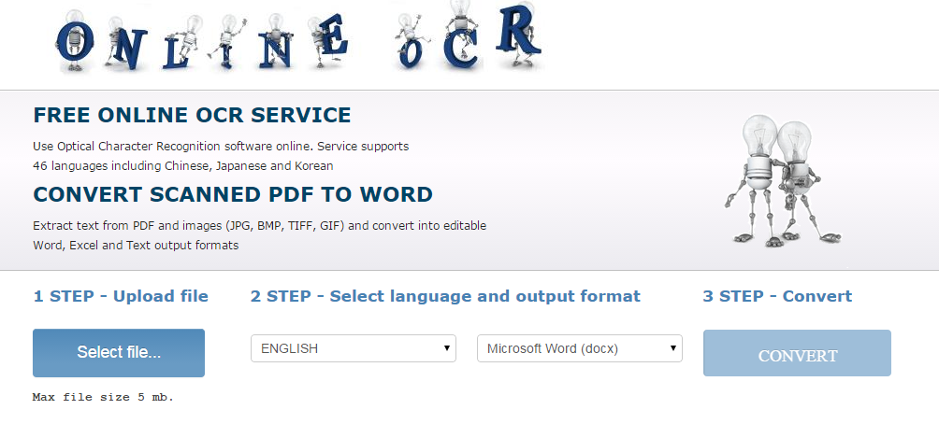
IMAGE SCRAPING
Free OCR (http://www.free-ocr.com)
2. Online OCR (http://www.onlineocr.net)

Slide 12
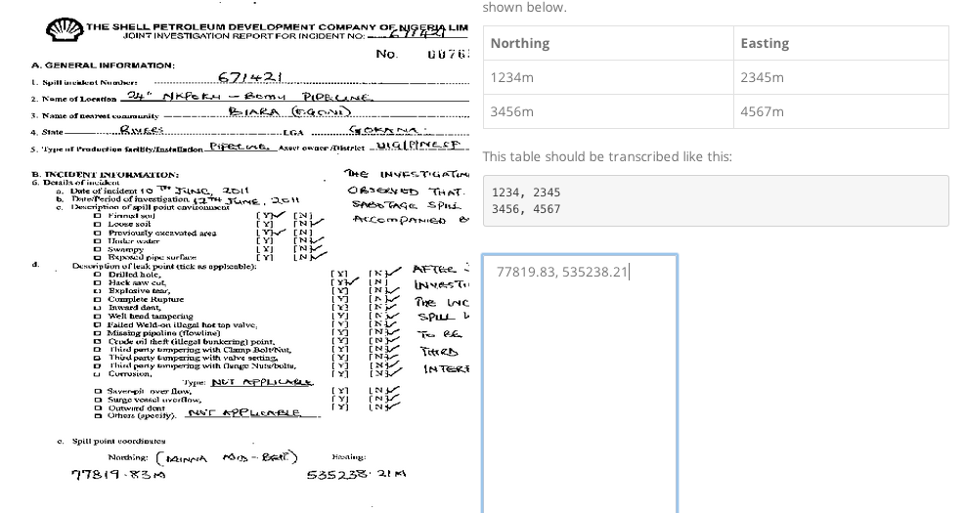
IMAGE SCRAPING
3. CrowdCrafting (http://crowdcrafting.org/)

Slide 13
Data Restructuring

Slide 14
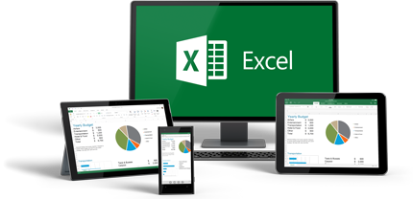
TABLE RESTRUCTURING
Remove titles / footers / logos / attributes,
Use a single table header,
One column, one data type,
Calculated columns or rows are not necessary,
Anonymize non-public information.
Remove blank rows / spacing

Slide 15
Data Cleaning

Slide 16
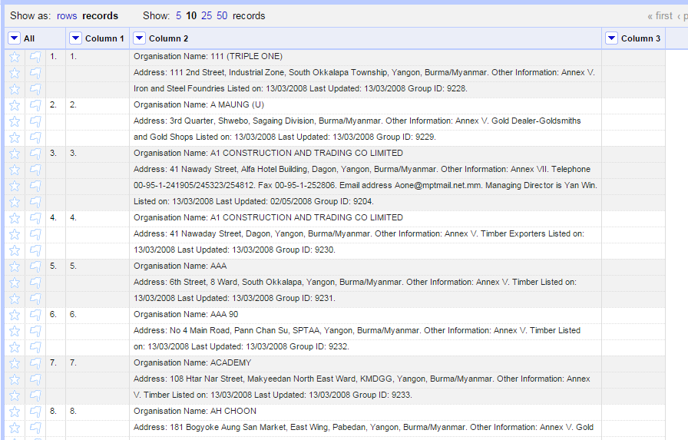
DATA CLEANING
OpenRefine (http://openrefine.org/)

Slide 17
Data Visualing

Slide 18
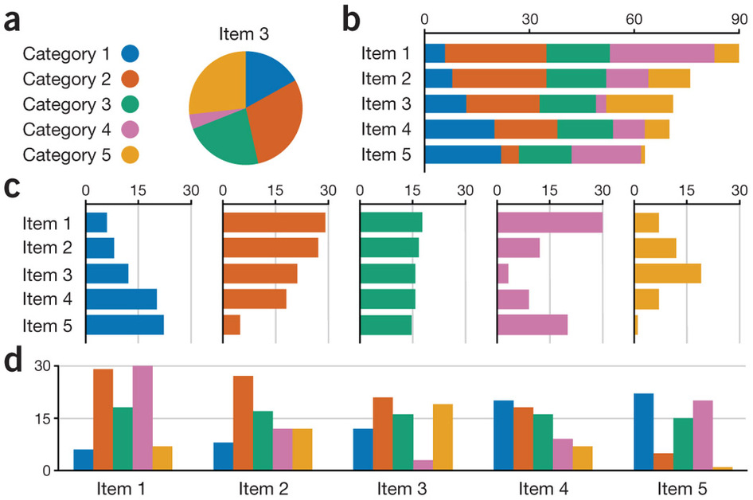
DATA VISUALISATION
Microsoft Excel

Slide 19
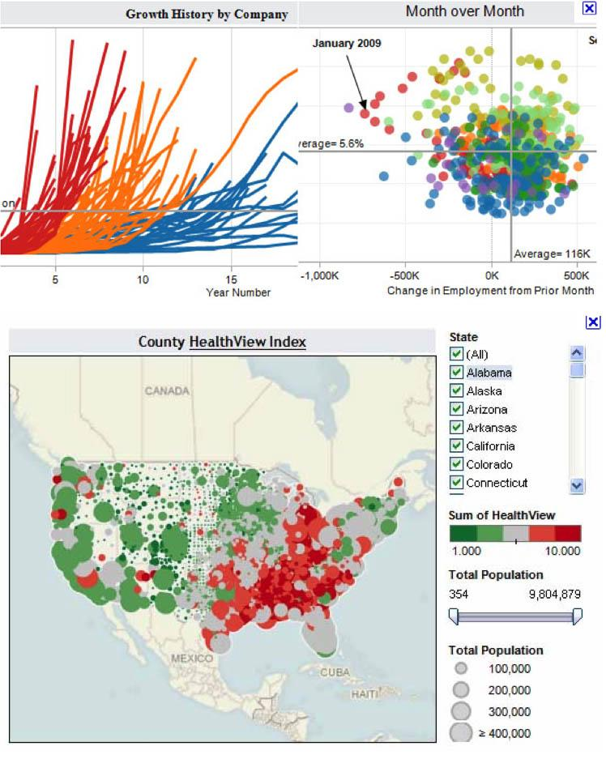
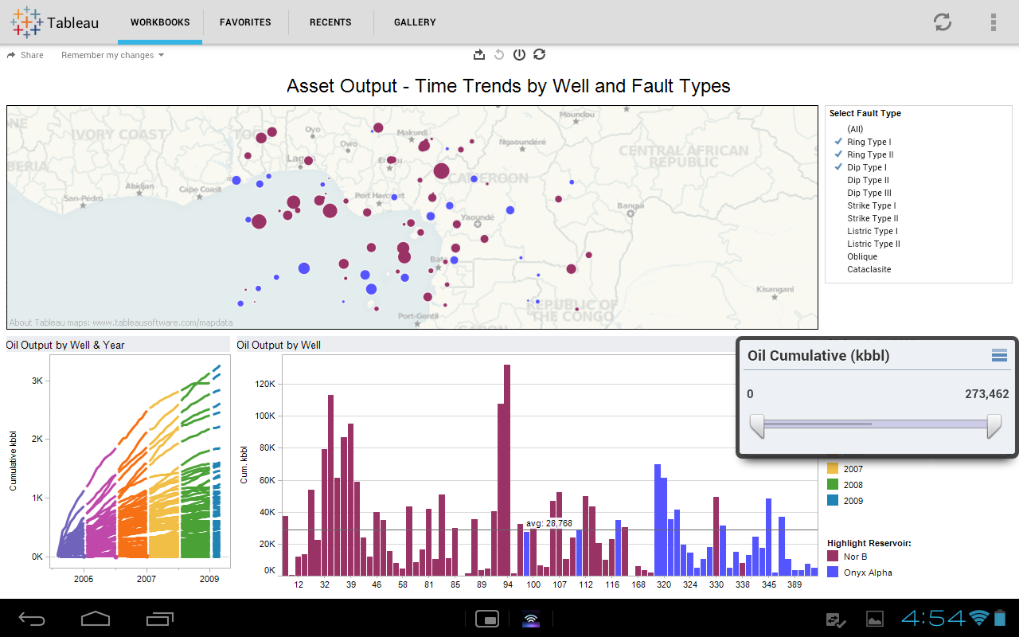
DATA VISUALISATION
Tableau Public (http://www.tableau.com/public/)

Slide 20
QUESTIONS?

Slide 21
RESOURCES
Google Docs - http://drive.google.com
Tabula - http://tabula.technology (v0.9.7)
PDF Tables - https://pdftables.com
Free OCR - http://www.free-ocr.com
Online OCR - http://www.onlineocr.net
CrowdCrafting - http://crowdcrafting.org
OpenRefine - http://openrefine.org (v2.6)
Tableau Public - http://www.tableau.com/public/ (v8.3)

Slide 22
This work is licensed under a
Creative Commons Attribution 4.0
International License.

