Slide 1
A Right to Data? Legal and Practical Challenges at the Intersection of Freedom of Information and Open Data 24 March 2015, Rightscon 2015 Manila, Philippines
www.labs.webfoundation.org @ODLabJkt

Slide 2
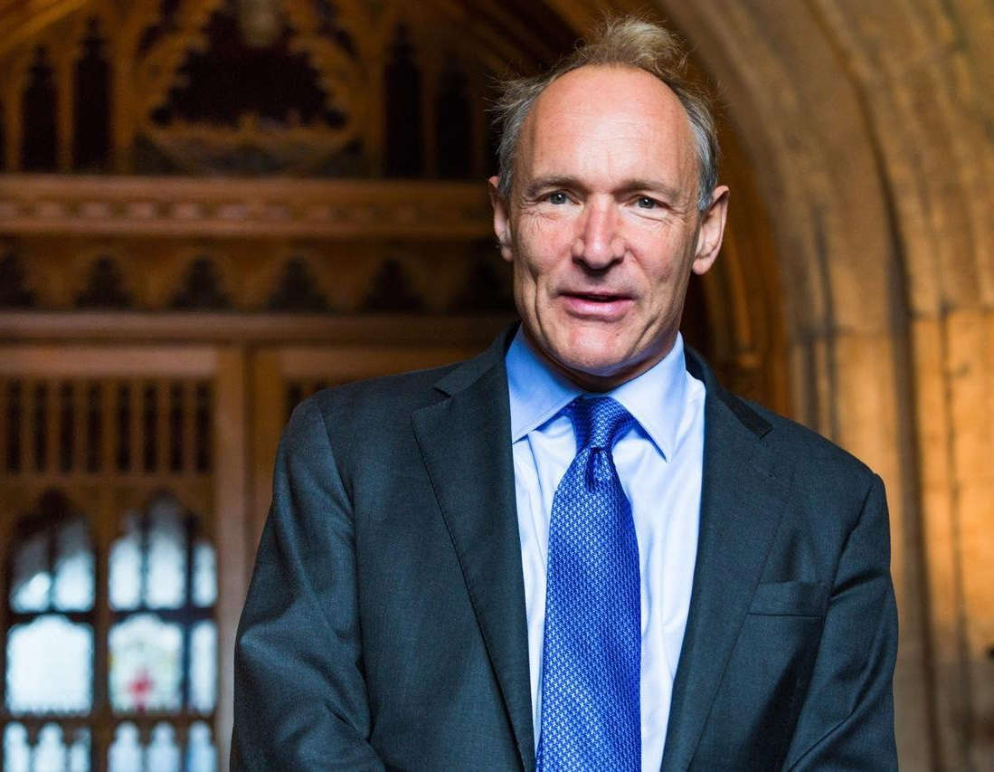
Open Government Data
and
Open Data for Developing Countries
Notes:
Tim Berners-Lee established the Web Foundation >> The Labs is part of the Web Foundation >> While exploring the potentials and uses of Open Data, the ‘Open Government Data’ and ‘ODDC’ projects were formed, of which the ‘Readiness Assessment Indonesia’ report is part of >> which led to opening the first Lab in Indonesia >> Ask: What is open data?

Slide 3
RESEARCH
INCUBATION
TRAINING
ENGAGEMENT
www.labs.webfoundation.org
Notes:
How do we work and deal with open data? We determine projects based on the ‘RITE’ approach, and build tailored approaches for each situation (succeeding slides):
Research: We conduct and support thematic research into the use and impact of open data in developing and emerging countries.
Incubation: We provide advice to build and expand the knowledge and skills needed to supply, access, and utilise open data.
Training: We strengthen capacities to help stakeholders understand the opportunities and challenges of open data, and to acquire the skills required to work with open data.
Engagement: We build and foster a diverse, interdisciplinary community through events, workshops and trainings.

Slide 4
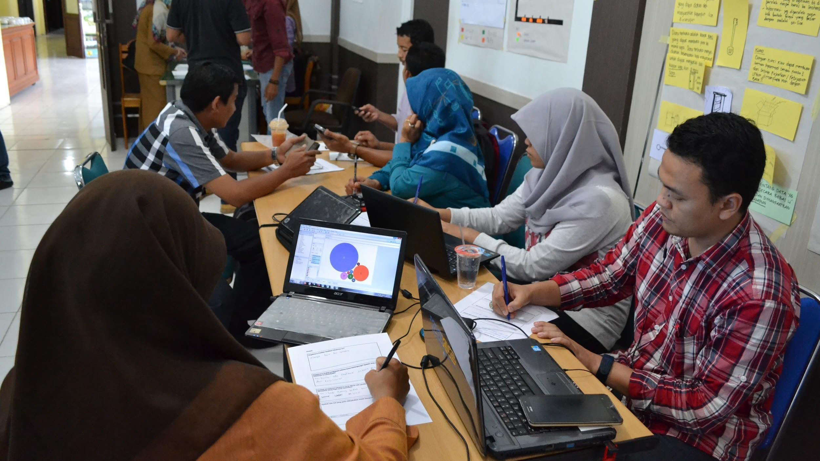
Opening Data for Better Education in Aceh
Notes:
Three workshops that (1) bridged the demand and supply sides, (2) capacitated both the government and the CSOs, and (3) facilitated a dialogue between the local government and the CSOs. Bonus: the project inspired other agencies in Aceh to also open up their data.

Slide 5
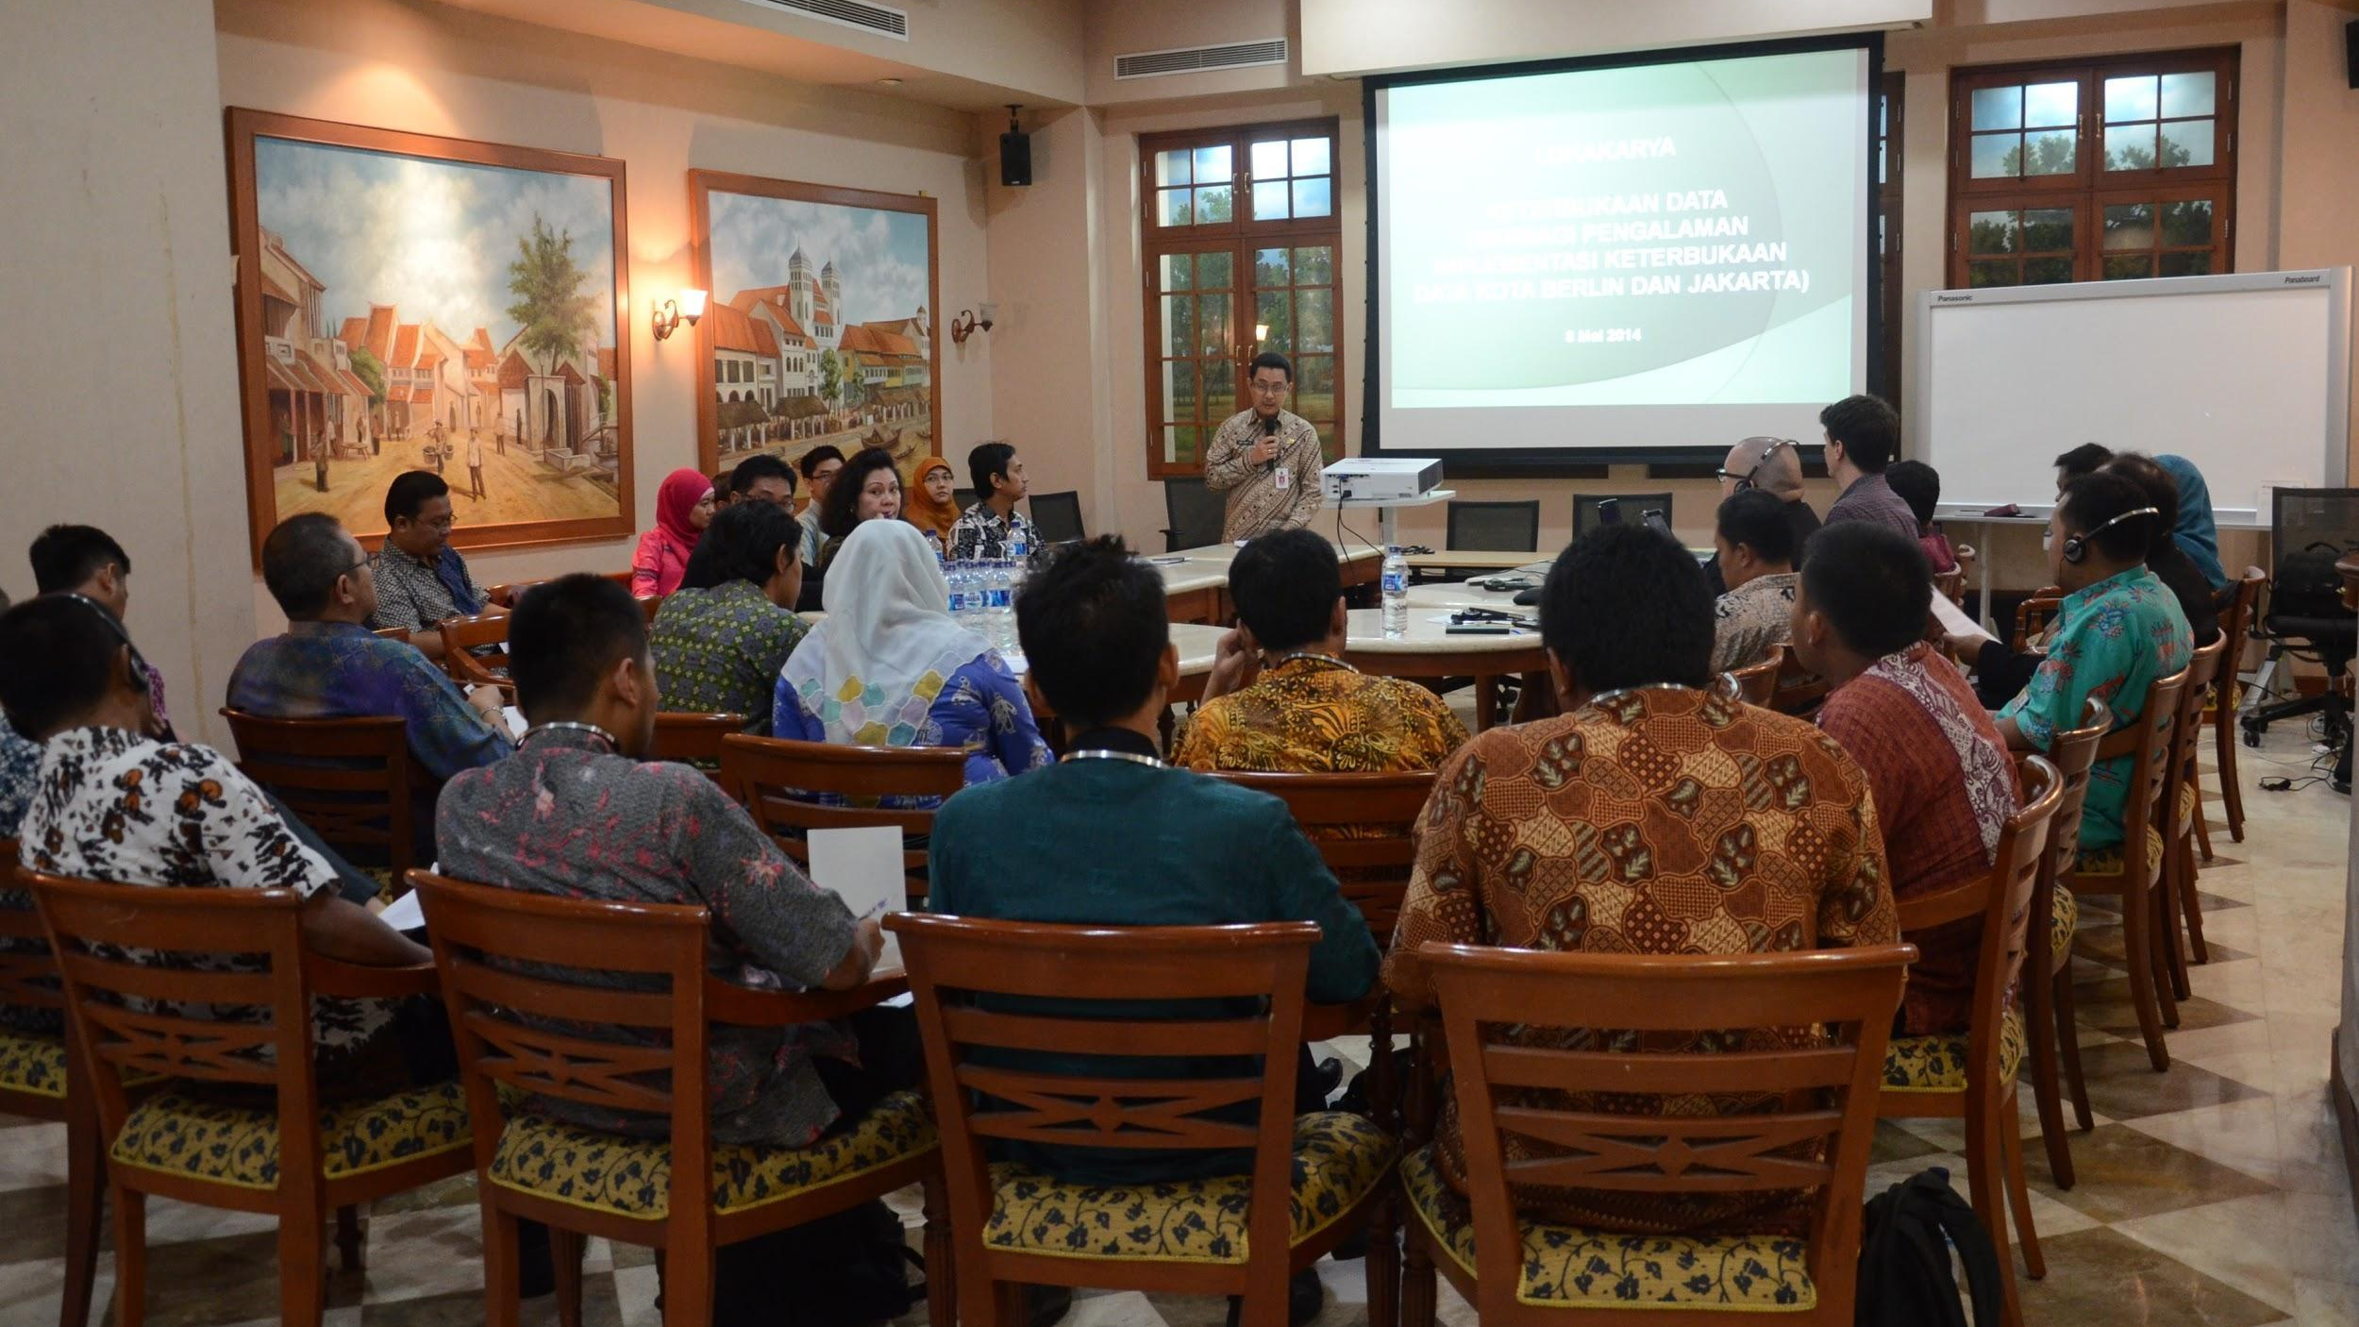
Towards Demand-Driven and Inclusive Open Data in Jakarta
Notes:
Sending representatives to Berlin to experience and learn more about their open data initiatives and then apply it to Jakarta,
Act No 181/2014 from Ahok,
Development and release of technical handbook,
OPTIONAL: Release of data sets from various agencies (health, education, civil registry, urban planning, disaster management, fire-fighting),
OPTIONAL. #HackJak

Slide 6
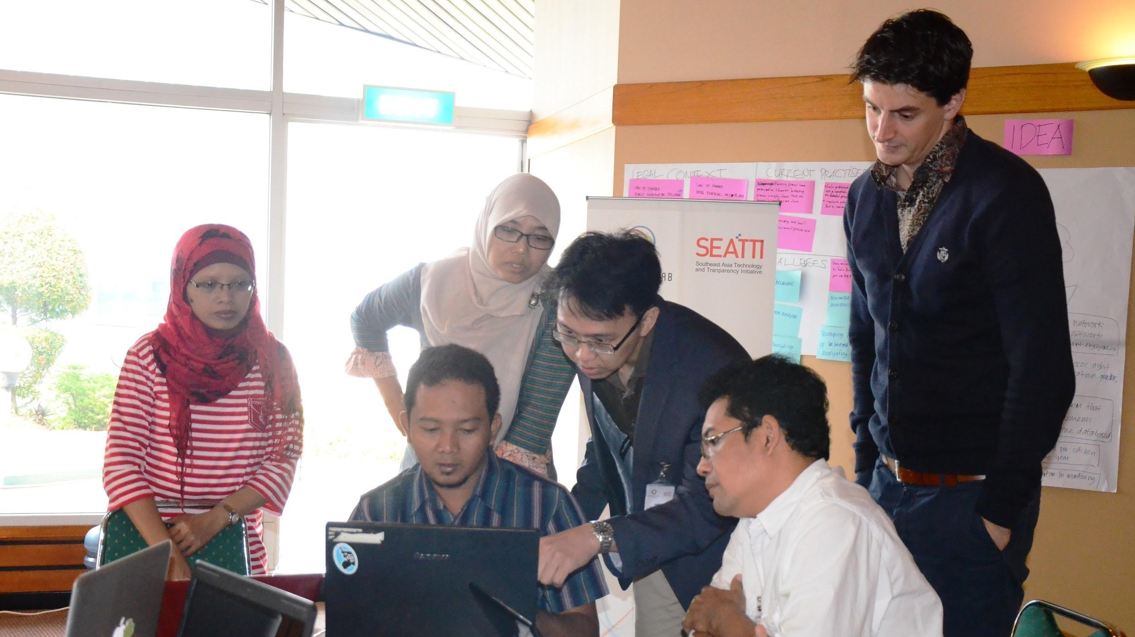
Empowering Civil Society—Strengthening Financial Transparency
Notes:
Projects in Indonesia and the Philippines that use a mentoring approach; 4 partners (2 in ID and 2 in PH) each working on their own transparency issues and priorities. Our partners are E-Net and INCITEGov in the Philippines, and Pattiro Surakarta and Perkumpulan IDEA in Indonesia. We work on issues of fiscal transparency on the local level, with each partner delving in their respective cities/local government data.

Slide 7
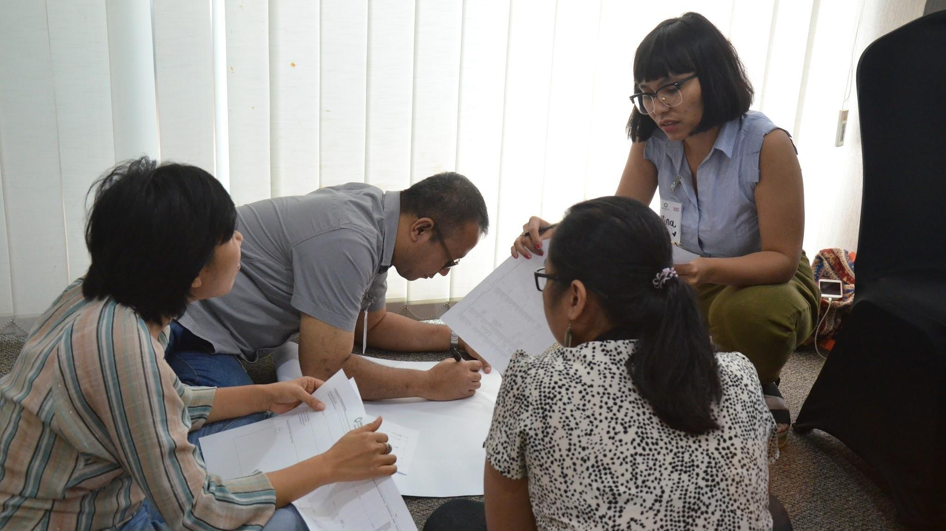
Trainings: Appreciating the Role of Open Data in Development
Notes:
We provide different kinds of trainings and workshops tailored to various needs and demands.

Slide 8
The Web Foundation’s Open Data Program
www.labs.webfoundation.org
Notes:
Our partners (financial and programs)

Slide 9
Our Partners
www.labs.webfoundation.org
Notes:
Our partners (funders, project partners, etc.)

Slide 10
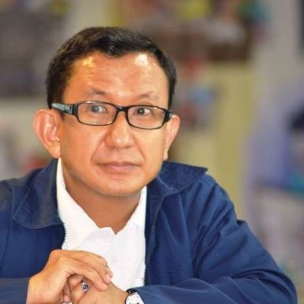
Right to Data: Challenges at the Intersection of Freedom of Information and Open Data
Silvana Fumega
University of Tasmania
Australia
Firmansyah MS
Kinerja
Indonesia
Gabe Baleos
Open Data Task Force
Philippines
Ivy Ong
Open Data Task Force
Philippines
www.labs.webfoundation.org

Slide 11
Right to Data: Challenges at the Intersection of Freedom of Information and Open Data
Michael Canares
Open Data Labs
Indonesia
Josef Hardi
Open Data Labs
Indonesia
Denise Karunungan
Open Data Labs
Indonesia
www.labs.webfoundation.org

Slide 12
PRELIMINARY WORKSHOP: „Participatory Ideation“
You can answer the questions on your own or with the person beside you.
Note that cards are color-coded.
What is the link between freedom of information (FOI) and open data (OD)?
What challenges do we foresee in terms of ensuring that FOI and OD will achieve
Its intended benefits in governance?
How do we deal with these challenges?
www.labs.webfoundation.org

Slide 13
Silvana Fumega University of Tasmania

Slide 14
RTD = RTI + ICT?
Is it that simple?

Slide 15
Right to Data (RTD)
Is OGD is taking an advocacy path similar to the RTI movement? If so, why?
Using the rights approach has proven to be a very useful advocacy and dissemination tool. However, does OGD need that diffusion tool when this initiative has been translated and adopted by a large number of countries? (developed and developing countries)

Slide 16
Some basic definitions:
RTI: Right to access information (in most cases in documents but not
exclusively) held and/or produced by the public sector
OGD: Data in reusable digital format, held and/or produced by
governments or by other parts of the public sector

Slide 17
Differences between both fields (through the lenses of civil society actors)
 | FOI | OGD
Object | Information (in most cases in documents but not exclusively) held and/or produced by public sector Requester has, in most cases, the right to express a desired format | Data in reusable digital format, held and/or produced by public sector. Open format is inherent to the initiative
Focus: re: info/data | Reducing information asymmetry (focus on access) | Focus on re- use (added value)
Copyright licensing | Varies between countries: Some (like USA) have no restrictions on republication Other FOI laws do not alter copyright laws, so rights to reuse may be limited | Inherent in OGD is that a license is granted to the user to reuse, republish the data
Approach | Legalistic (mostly) | Technical + policy (mostly)
Relationship w/ public sector (govt.) | Adversarialism | Utilitarianism (collaboration)
Philosophical background | Classic liberalism (theory of democracy) | Liberal utilitarianism, Libertarian socialism

Slide 18
It is clear that the “Right to Data” will facilitate the access but not necessarily the reuse
However, without access, there is no chance of re-use …
Right to Data =
RTI + open formats + reuse

Slide 19
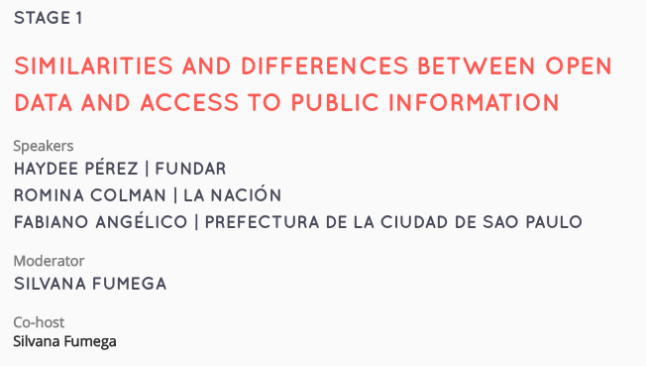
A FEW LESSONS FROM CONDATOS
(III Latin American Regional Conference on Open Data)
More info (in Spanish: http://silvanafumega.blogspot.com.au/2014/10/breve-resumen-de-la-charla.html)

Slide 20
RTI advocacy organizations and/or OGD advocacy organizations are not taking both agendas as an entire package
Each type of organization is taking elements of the other field to complement their own advocacy work.
e.g. http://subsidiosalcampo.org.mx/desarrolladores/datos-abiertos/
Some investigative journalists are taking these two elements as two valid tools to gather information for their work (not as an agenda to promote though). e.g http://interactivos.lanacion.com.ar/declaraciones-juradas/

Slide 21
“Even though these two approaches to government data and information are complementary, these two groups are not closely collaborating with each other, as one could imagine. Differences in approaches, languages, skills seem to build barriers for their interaction. However, those differences are the key elements that make this collaboration necessary.”
More info: http://www.ogphub.org/blog/ogd-and-foi-different-approaches-to-government-information-and-data/

Slide 22
Firmansyah MS
Kinerja – USAID
Linking Freedom of Information and Open Data
for Greater Transparency and Participation in Banda Aceh

Slide 23
About KINERJA - USAID KINERJA is a governance program focused on improving public service delivery in Indonesia. The program works with local governments (including PPID – Information and Documentation Official) related to Freedom of Information Issue) to make service delivery (on health, education and business licensing) more responsive to the needs of its users, while also working with civil society, communities, and the media to build their capacity to demand higher quality services from their governments.
Notes:
The program works with local governments (including PPID – Information and Documentation Official) related to Freedom of Information Issue) to make service delivery (on health, education and business licensing) more responsive to the needs of its users, while also working with civil society, communities, and the media to build their capacity to demand higher quality services from their governments.

Slide 24
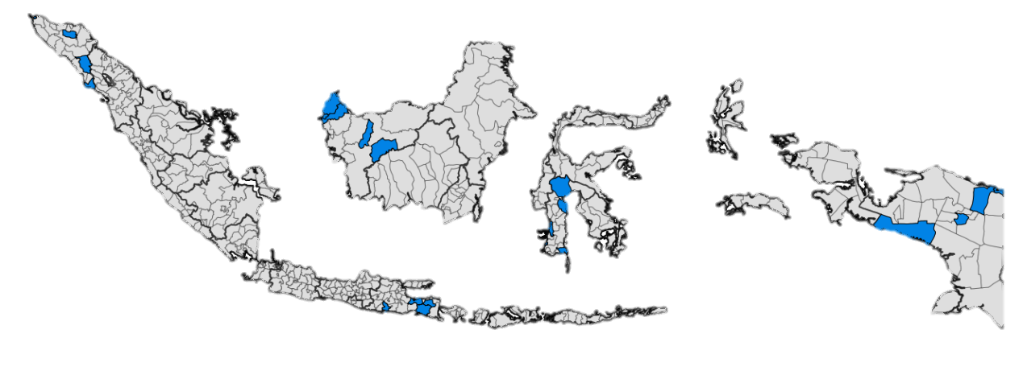
Kinerja Program Locations
Aceh
West Kalimantan
Papua
South Sulawesi
East Java
Kinerja works in five districts in each province

Slide 25
A project of World Wide Web Foundation and Kinerja
funded by the USAID, implemented by the Open Data Lab Jakarta The project was implemented from 1 November – 15 December 2014
in Banda Aceh, Indonesia in partnership with GeRAK Aceh and
the city government of Banda Aceh.

Slide 26
The project intended to achieve the following objectives:
• Assess the data needs of civil society organizations (CSOs) and their constituents to match with information disclosure practices of the city government;
• Support the city government in understanding the key priority information and data needs of CSOs and their constituents;
• Increase the capacity of CSOs (including the mass media) to understand, use, and translate government data into actionable information for the use of citizens and disseminate these for wider impact. ***

Slide 27
CHALLENGES
SUPPLY SIDE INTERVENTIONS
BRIDGE SUPPLY AND DEMAND
Low level of government information available to citizens
FOI law passed & implementation in government agencies
DEMAND SIDE INTERVENTIONS
Why
isn’t it working?
Government frustrated with the limited impact of investments into FOI
Uptake and use of FOI very low
Notes:
1: Low level of government information available/accessible to citizens > resulting in issues around government transparency, accountability, responsiveness, impartiality etc.
3: Uptake and use of FOI very low. citizens, journalists, CSOs not using the tool to request information….
4: Government (and donors) frustrated as limited impact of investments into FOI work although convinced of the need, right and usefulness for citizens to be able to access information to advance good governance (transparency, accountability etc.)

Slide 28
BRIDGING SUPPLY AND DEMAND THROUGH OPEN DATA
We’ll
help!
Education!
We want to open data.
Phase 1:
Helped intermediaries articulate and prioritize information needs
Phase 2:
Engagement with government for data release and training
Phase 3:
Capacity-building for intermediaries
Phase 4:
Enable the exchange between government and intermediaries
Notes:
Phase 1: Helped intermediaries articulate and prioritized information needs (education sector)
Phase 2: Engagement with government around information/data supply and training to make datasets available as open data (proactive disclcoure)
Phase 3: Capacity-building for intermediaries to understand, analyze and visualize data based on their needs and issues
Phase 4: Enable exchange between govt and intermediaries to discuss issues in education sector based on analyzed data

Slide 29
LOOKING AT SCHOOL PERFORMANCE BASED ON AWARDS
Figure 1. Awards Received by Schools - 2011 to 2014
Notes:
11 out of 46 school won competition from 2011- 2014
SMA T. Nyak Fatih won several science competitions, SMAN 7 won only in sports, and SMAN 10 in art and social science
It raises question: if we want to improve school performance, which subject should we focus on?
Samples of participants’ outputs are presented below:
Case 1: Assessing School Performance in Banda Aceh
One of Group in the workshop used the datasets (awards obtained by schools) to assess school performance. Accordingly, they figured out that only eleven (11) SMAs (out of 46) in Banda Aceh won school competitions in 2014, as shown in the graph of Figure 1 (the entire visualization does not fit in a single screen).
It also shows that the schools received less awards in 2014 compared with previous years.
However, granularity is necessary for this presentation to become more useful. For example, granular data is available for the locale (e.g. local, national, international) of awards, schools that received these awards (e.g. private, public), and the nature of the awards received (e.g. subject-related, arts or culture related, among others). This way, we are able to say, that though the overall total of awards declined, the awards related to basic skills such as language, math and science, have increased. Without this level of detail, people may arrive at generalizations that may cloud good analysis and judgment.

Slide 30
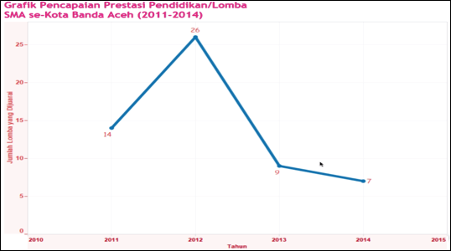
Figure 2. Number of Awards received by Schools
It is important to look at the reasons why the awards received by schools declined in 2014 (see Figure 2). The visualization can be made a good basis in discussing the factors contributing to low achievement and the measures necessary to be implemented to address these factors.

Slide 31
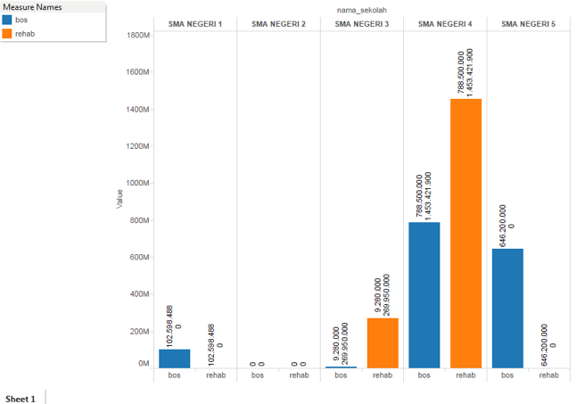
Figure 3. BOS Utilization
Notes:
Case 2: BOS (School Operational Fund) Budget Usage
One participant group explored budget allocation and realization datasets to validate the report from students that their organization gathered based on school surveys. The students in their survey reported that their school did not have sufficient infrastructures to support teaching and learning activities. The group analyzed BOS fund usage using available dataset and identified schools receiving and using BOS fund to improve their infrastructures.
Figure 3 only shows a portion of the whole visualization file but it raises significant issues. First, it shows that there are some schools that did not receive any BOS funds (e.g. SMA Negeri 2) while others received large amounts (e.g. SMA Negeri 4). Clearly, there are differences in the amount of allocation that schools receive and this raises the question as to the basis for fund allocation.
Second, there are differences in allocation and utilization. For example, in some schools, utilization is zero or low compared to allocation, while in others, utilization is higher than allocation. Thus, it is necessary to look again at the data to understand this trend and find reasons for these discrepancies.

Slide 32
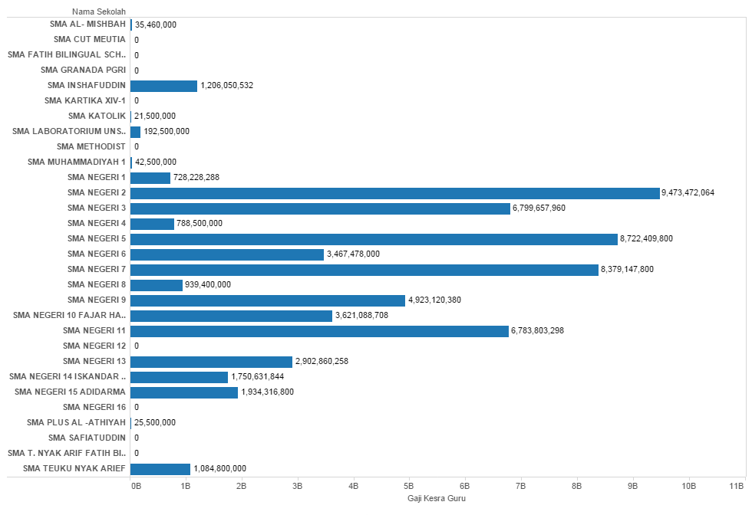
Figure 4. Data on Teachers’ Salary
However, there are at least two insights in this case. First, data context is important. Spending on salaries is essentially related to the number of teachers. As such, it might be good to look at spending per teacher rather than spending on salaries (total). Secondly, there is a need to look at data quality, because Figure 4 above shows some schools have zero salary spending values.
Notes:
Case 3: Teacher’s Salary and School Performance
Another Group explored data showing the budget allocation for teaching salary staff. The data revealed that public SMA spent more for teacher’s salary than private SMA. The highest, SMA N 2, spent over 9B IDR.
Meanwhile the lowest, SMA Katolik spent slightly above 21M IDR. Comparing this data with that of awards received, they argued - to a degree – that budget spending for teaching staff have implications on school performance.

Slide 33
Lessons learned and steps moving forward
On CSOs Awareness regarding FOI and Open Data
• While access to information has improved for at least three (3) CSOs represented in the workshops, the majority of the CSOs in Banda Aceh have not exercised their right primarily because of lack of awareness on how to exercise or avail of their right to information and the perception that exercising it is cumbersome.
• There is low awareness on the part of CSOs regarding open data. They associate open data with web applications. Only after an explanation of open data concepts were the participants able to see its value and how it complements with freedom of information.

Slide 34
Lessons learned and steps moving forward
On Government’s Attitude towards FOI and Open Data
• The key to the success of the project was the commitment of local government leaders. Had government leaders not expressed commitment to proactively disclose data and had their staff trained in to do so, the CSO workshop, the main intention of the project, would not have happened.
• Civil servants see the value of sharing information to the public. Most of them expressed the commitment that if CSOs will ask for specific information, for as long as these are available, they will provide it.
• However, while there is interest in proactively disclosing information to the public, there is also a certain degree of apprehension in opening up data. Civil servants are afraid that the data would fall into the wrong hands, that it could be misused, and that those having access to it could modify the data to the disadvantage of government.

Slide 35
Lessons learned and steps moving forward
Open data allowed for objective and informed discussions between groups, with better understanding from both sides about their challenges and issues faced.
With data supply informed by actual data needs and priorities of intermediaries and users, an uptake of the data is ensured.
Notes:
Lessons learned:
Enable CSO and government to identify challenges (in education sector) based on data - not opinions
Data/information published by government matches the actual needs of CSOs
Unintended outcome: it motivated other department to release their data (i.e. Dep of transportation, communication and information published 14 datasets in the portal)
Next step for ODL:
Continue working with the city gov
Organise training for key gov personnels to open up data
Help PPIDs to upload the FoI requests and replies online in open formats

Slide 36
Lessons learned and steps moving forward
Unintended outcome:
The project prompted other agencies in Banda Aceh to release data as well, accessible online.
http://data.bandaacehkota.info/group/dishubkominfo-banda-aceh
This Open Data site is growing very rapidly providing data, not only from the education sector but also other sectors, such as transportation, broadcast media outlets and internet cafe. The data contained also follow global standards, as .csv format it will be easier to use the public and the media in putting it back together as a report or news that will be presented to the public, particularly the policy makers.
Notes:
Lessons learned:
Enable CSO and government to identify challenges (in education sector) based on data - not opinions
Data/information published by government matches the actual needs of CSOs
Unintended outcome: it motivated other department to release their data (i.e. Dep of transportation, communication and information published 14 datasets in the portal)
Next step for ODL:
Continue working with the city gov
Organise training for key gov personnels to open up data
Help PPIDs to upload the FoI requests and replies online in open formats

Slide 37
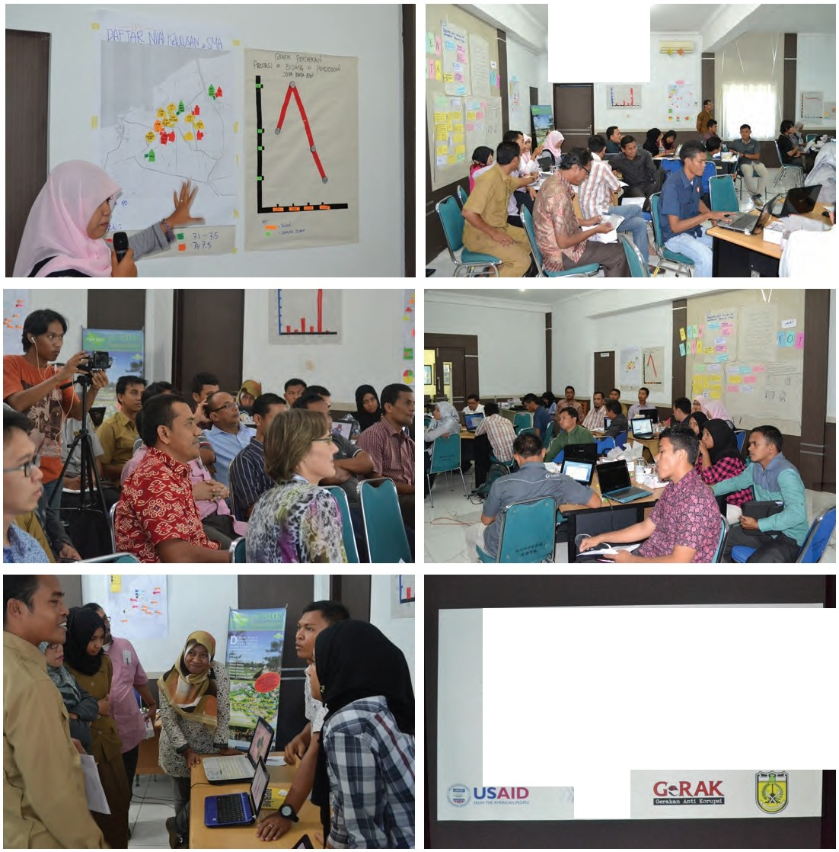
Participants from the 3rd Workshop and the public event (pictures).
Participants presented their offline and online visualizations as results of the workshop, with our partners from the Banda Aceh City Government, GeRAK Aceh and Kinerja watching their presentations.
The workshop ended with all present voting on who they thought had the best examples of online and offline data visualizations.
OPEN DATA LABS
LOKAKARYA
KEBEBASAN INFORMASI PUBLIK
DAN KETERBUKAAN DATA
UNTUK MENINGKATKAN TRANSPARANSI DAN PARTISIPASI MASYARAKAT

Slide 38
Gabe Baleos
Open Data Task Force Philippines

Slide 39
Challenges in
Open Government Data

Slide 40
The open government agenda is a political agenda that needs to emanate from the highest political leadership.
The challenge is how to make openness – transparency, accountability, and citizen participation – continuously reaffirmed by our political leaders in every election, in every key political moment, and in day-to-day operations of governance.

Slide 43
Cabinet Cluster on
Good Governance & Anti-Corruption
30+ Initiatives
Transparency and Citizens’ Empowerment
Public Sector Performance
Anti-Corruption
9 Priority Legislations
Chair: The President
Members: Dep’t of Budget and Management (Secretariat)
Dep’t of Finance, Dep’t of the Interior and Local Government, Dep’t of Justice,
Dep’t of Trade and Industry, Presidential Legislative Liaison Office,
Office of the Presidential Legal Counsel

Slide 45
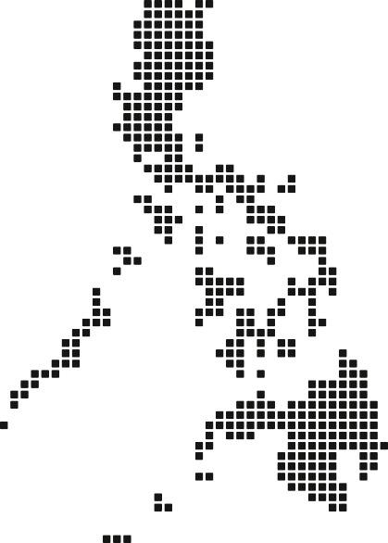
2015 General Appropriations Act
Sec. 26. Open Government Data. Departments, bureaus, and offices of the National Government, including Constitutional Offices enjoying fiscal autonomy, SUCs, and GOCCs shall adopt a policy of openness for all datasets created, collected, processed, disseminated, or disposed through the use of public funds to the extent permitted by applicable laws and subject to individual privacy, confidentiality, national security, or other legally-mandated restrictions. Openness means that datasets published by agencies shall be machine-readable, in open formats, and released with open licenses.
Implementation of this section shall be subject to guidelines to be issued by the Open Data Philippines Task Force comprised of the Office of the Presidential Spokesperson, DBM, and the Presidential Communications Development and Strategic Planning Office.

Slide 46
The motivation to do open data, in our experience, is transparency.
We have yet to see efficiency, such as improved service delivery and generation of economic and commercial activity, as a motivation to practice open data.
The challenge is how to make the case for efficiency.

Slide 47
Intellectual Property Code of the Philippines
Sec. 176. Works of the Government. – 176.1 . No copyright shall subsist in any work of the Government of the Philippines. However, prior approval of the government agency or office wherein the work is created shall be necessary for exploitation of such work for proft. Such agency or office may, among other things, impose as a condition the payment of royalties. No prior approval or conditions shall be required for use of any purpose of statutes, rules and regulations, and speeches, lectures, sermons, addresses, and dissertations, pronounced, read or rendered in courts of justice, before administrative agencies, in deliberative assemblies and in meetingsof public character.

Slide 48
Open Data operates on trust.
And it is expected that the integrity and accuracy of government data will be questioned.
The challenge for governments is to reduce human intervention in the life cycle of datasets from the moment it is collected to the point of release.

Slide 49
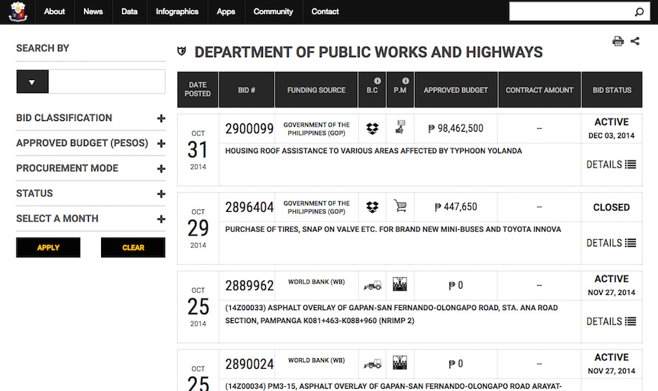

Slide 50
politics, efficiency, trust

Slide 52
Michael Cañares
Open Data Lab Jakarta

Slide 53
Empowering Civil Society—Strengthening Financial Transparency
Notes:
Projects in Indonesia and the Philippines that use a mentoring approach; 4 partners (2 in ID and 2 in PH) each working on their own transparency issues and priorities. Our partners are E-Net and INCITEGov in the Philippines, and Pattiro Surakarta and Perkumpulan IDEA in Indonesia. We work on issues of fiscal transparency on the local level, with each partner delving in their respective cities/local government data.

Slide 54
Perkumpulan IDEA http://perkumpulanidea.or.id/ Yogyakarta, Indonesia
Has a long tradition of translating budget information to accessible information by local citizens.
The Indonesian FoI Act No 14 2008, classifies three types of information:
Serta Merta: Information that must be disclosed immediately
Berkala: Information that must be released periodically
Setiap Saat: Information that should be made available anytime
But the public were not able to make use of the mechanism due to limited capacity.

Slide 55
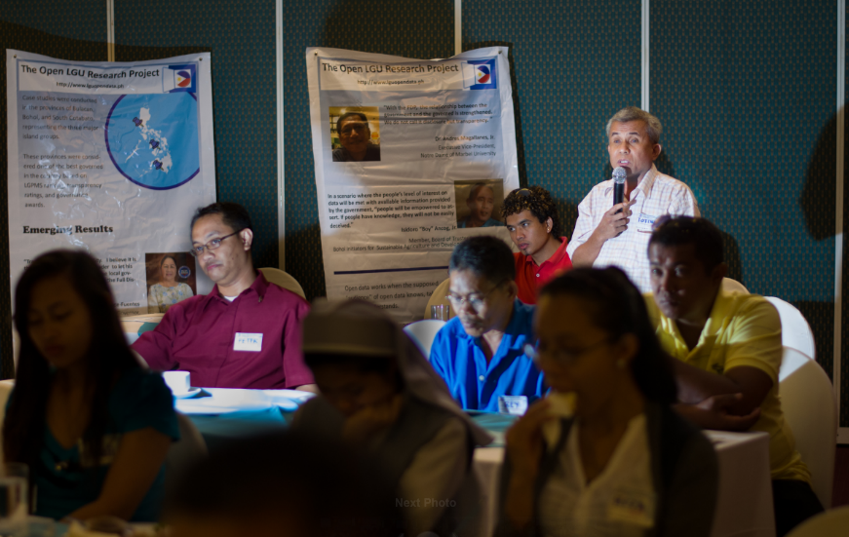
Understanding Supply and Use of Government Data in the Philippines
Notes:
Projects in Indonesia and the Philippines that use a mentoring approach; 4 partners (2 in ID and 2 in PH) each working on their own transparency issues and priorities

Slide 56
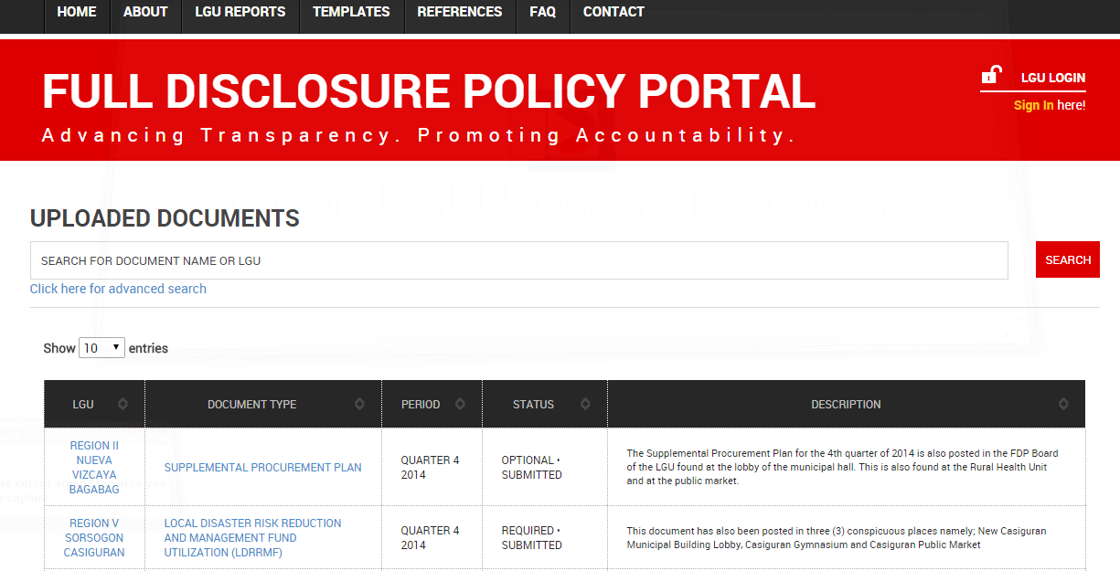
Open LGU Research Project http://www.lguopendata.ph/ Philippines
The Department of Interior and Local Government mandates local government units to proactively disclose select financial reports at the FDP portal or in local government websites.
The initiative aims to make government information accessible to the public.
But since its implementation in 2011, the citizen, and even civil society organizations, have not made use of the information to advance participation or promote accountability.

Slide 57
Different Information Regimes – Similar Challenges
Awareness of local citizens in both Philippines and Indonesia is low.
Access is limited.
There are technical and institutional barriers to access.
Interest in government data is affected by several factors.
Not all data or information is easily understandable.
Notes:
Internet access in 2014 (ITU) 16% in Indonesia, 37% in the Philippines. Broadband Commission report says that in 2013, internet penetration in Indonesia was 5.7% while that of the Philippines was 23%.

Slide 58
The NEED for INTERMEDIARIES
Lessons for Moving Forward
There is mismatch between information needs and information provided.
Digital divide affects both supply and demand.
Intermediaries are critical to ensure that data supply and use brings positive results.

Slide 59
Find out more about us and our projects
www.labs.webfoundation.org
@ODLabJkt
Jl. Pati No 1, Menteng, Jakarta 10310
Notes:
Contact us

Slide 60
This work is licensed under a
Creative Commons Attribution 4.0 International License.

